Slide 1
Life Cycle Models
(Lect 2)
Dr. RAJIB MALL
Professor
Department Of Computer Science & Engineering
IIT Kharagpur.

Slide 2
Quiz
Give one example project situation for which waterfall model is suitable.
Give one example project situation for which waterfall model is not suitable.
What is a milestone? Give one example of a milestone.
In what way are milestones useful?
How frequently should milestones be placed?
What problems may be encountered if a project manager recommends use of the iterative waterfall model for a customization project?

Slide 3
Quiz
Suppose the sales manager of your company informs the top management of your company that he sees tremendous potential for a wearable health monitor:
  The wearable health monitor would measure vital body parameters such as heart rate, temperature, blood pressure, etc and maintain a log.
How would you perform feasibility study?

Slide 4
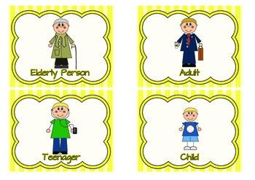
Human Life Cycle

Slide 5
Software Life Cycle
Conceptualize
Specify
Retire
Design
Maintain
Deliver
Code
Test

Slide 6
Life Cycle Model
A software life cycle model (also process model or SDLC):
  A descriptive and diagrammatic model of software life cycle:
  Identifies all the activities undertaken during product development,
  Establishes a precedence ordering among the different activities,
  Divides life cycle into phases.

Slide 7
Life Cycle Model (CONT.)‏
Each life cycle phase (activity) consists subactivities.
  For example, the design stage might consist of:
    structured analysis
    structured design

Slide 8
Why Model Life Cycle?
A graphical and written description:
  Helps common understanding of activities among the software developers.
  Helps to identify inconsistencies, redundancies, and omissions in the development process.
  Helps in tailoring a process model for specific projects.

Slide 9
Life Cycle Model (CONT.)‏
The development team must identify a suitable life cycle model:
  and then adhere to it.
  Primary advantage of adhering to a life cycle model:
    Helps development of software in a systematic and disciplined manner.

Slide 10
Life Cycle Model (CONT.)
When a program is developed by a single programmer ---
  The problem is within the grasp of an individual.
  He has the freedom to decide his exact steps and still succeed ➔Exploratory model
  Code➔Test ➔Design
  Code➔Design ➔Test ➔ Code
  Specify ➔code ➔Design ➔Test etc.

Slide 11
Life Cycle Model (CONT.)‏
When software is being developed by a team:
  There must be a precise understanding among team members as to when to do what,
  Otherwise, it would lead to chaos and project failure.

Slide 12
Life Cycle Model (CONT.)‏
A software project will never succeed if:
  one engineer starts writing code,
  another concentrates on writing the test document first,
  yet another engineer first defines the file structure
  another defines the I/O for his portion first.

Slide 13
Entry and Exit Criteria
A life cycle model:
  defines entry and exit criteria for every phase.
  A phase is considered to be complete:
    only when all its exit criteria are satisfied.

Slide 14
Life Cycle Model (CONT.)‏
What is the phase exit criteria for the software requirements specification phase?
  Software Requirements Specification (SRS) document is complete, reviewed, and approved by the customer.
A phase can start:
  Only if its phase-entry criteria have been satisfied.

Slide 15

Life Cycle Model (CONT.)‏
Milestones help software project managers:
  Track the progress of the project.
  Phase entry and exit are important milestones.

Slide 16
Life Cycle and Project Management
When a life cycle model is followed:
  The project manager can at any time fairly accurately tell,
    At which stage (e.g., design, code, test, etc.) the project is.

Slide 17
Project Management Without Life Cycle Model
It becomes very difficult to track the progress of the project?
  The project manager would have to depend on the guesses of the team members.
This usually leads to a problem:
  known as the 99% complete syndrome.

Slide 18
Myth: Deliverables and Milestones
Myth:
“The only deliverable for a successful project is the working program.”
Reality:
Documentation of all aspects of software development are needed to help in operation and maintenance.

Slide 19
Life Cycle Model (CONT.)‏
Many life cycle models have been proposed.
We confine our attention to a few important and commonly used models.
  Classical and Iterative waterfall models
  V model,
  Evolutionary,
  Prototyping
  Spiral model, and
  Agile models

Slide 20
Software Life Cycle
Software life cycle (or software process):
  Series of identifiable stages that a software product undergoes during its life time:
    Feasibility study
    Requirements analysis and specification,
    Design,
    Coding,
    Testing
    Maintenance.

Slide 21
Classical Waterfall Model
Classical waterfall model divides life cycle into following phases:
  Feasibility study,
  Requirements analysis and specification,
  Design,
  Coding and unit testing,
  Integration and system testing,
  Maintenance.
Conceptualize
Retire
Specify
Design
Maintain
Deliver
Code
Test

Slide 22
Classical Waterfall Model
Feasibility Study
Req. Analysis
Design
Coding
Testing
Maintenance

Slide 23
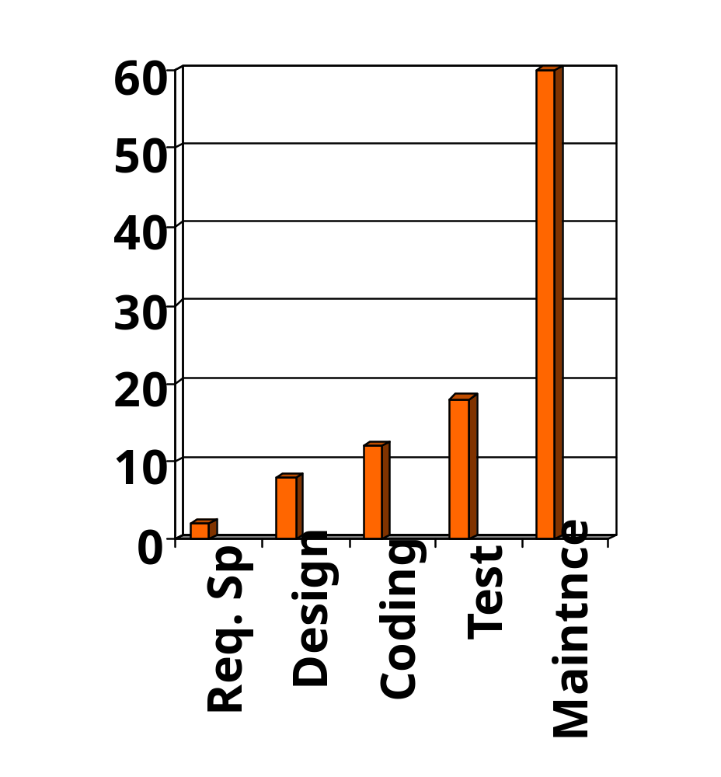
Relative Effort for Phases
Phases between feasibility study and testing
  Called development phases.
Among all life cycle phases
  Maintenance phase consumes maximum effort.
Among development phases,
  Testing phase consumes the maximum effort.
Relative Effort

Slide 24
Classical Waterfall Model (CONT.)‏
Most organizations usually define:
  Standards on the outputs (deliverables) produced at the end of every phase
  Entry and exit criteria for every phase.
They also prescribe methodologies for:
  Specification,
  Design,
  Testing,
  Project management, etc.

Slide 25
Classical Waterfall Model (CONT.)‏
The guidelines and methodologies of an organization:
  Called the organization's software development methodology.
Software development organizations:
  Expect fresh engineers to master the organization's software development methodology.

Slide 26
Feasibility Study
Main aim of feasibility study: determine whether developing the product
  Financially worthwhile
  Technically feasible.
Roughly understand what customer wants:
  Data which would be input to the system,
  Processing needed on these data,
  Output data to be produced by the system,
  Various constraints on the behavior of the system.

Slide 27
The business case
Benefits of delivered project must outweigh costs
Costs include:
  Development
  Operation
Benefits:
  Quantifiable
  Non-quantifiable
Benefits
Rs
Costs
Rs
Notes:
It is not always possible to put a precise financial on the benefits of a project. The client’s willingness to pay up to a certain price to get a project implemented implies that they have informally identified a value to them of getting that project implemented.

Slide 28
Case Study
SPF Scheme for CIL
CIL has a large number of employees, exceeding 50,000.
Majority of these are casual labourers
Mining being a risky profession:
  Casualties are high
Though there is a PF:
  But settlement time is high
There is a need of SPF:
  For faster disbursement of benefits

Slide 29
Activities During Feasibility Study
Work out an overall understanding of the problem.
Formulate different solution strategies.
Examine alternate solution strategies in terms of:
    resources required,
    cost of development, and
    development time.

Slide 30
Feasibility Study
Operational feasibility
Measure of how suitable system development will be to the company
Four feasibility tests:
Schedule feasibility
Economic feasibility (also called cost/benefit feasibility)
Technical feasibility

Slide 31
Feasibility Study Activities
Assesses feasibility
of each alternative solution
Presented to steering committee, which decides how system will be developed
Recommends the most feasible solution for the project

Slide 32
Activities during Feasibility Study
Perform a cost/benefit analysis:
  Determine which solution is the best.
  May also find that none of the solutions is feasible due to:
    high cost,
    resource constraints,
    technical reasons.

Slide 33
Cost benefit analysis (CBA)
Need to identify all costs --- these could be:
  Development costs
  Set-up
  Operational costs
Identify the value of benefits
Check benefits are greater than costs
Notes:
Section 2.4 of the text expands this material.
Exercise 2.1 requires students to identify the potential costs and benefits of the Brightmouth College payroll application.

Slide 34
Classical Waterfall Model
Feasibility Study
Req. Analysis
Design
Coding
Testing
Maintenance

Slide 35
Requirements Analysis and Specification
Aim of this phase:
  Understand the exact requirements of the customer,
  Document them properly.
Consists of two distinct activities:
  Requirements gathering and analysis
  Requirements specification.

Slide 36
Goals of Requirements Analysis
Collect all related data from the customer:
  Analyze the collected data to clearly understand what customer wants,
  Find out any inconsistencies and incompleteness in the requirements,
  Resolve all inconsistencies and incompleteness.

Slide 37
Requirements Gathering
Gathering relevant data:
  Usually collected from the end-users through interviews and discussions.
  Example: for a business accounting software:
    Interview all the accountants of the organization to find out their requirements.

Slide 38
Requirements Analysis (Cont...)‏
The data you initially collect from the users:
  Usually contain several contradictions and ambiguities.
  Why?
  Each user typically has only a partial and incomplete view of the system.

Slide 39
Requirements Analysis (Cont...)‏
Ambiguities and contradictions:
  must be identified
  resolved by discussions with the customers.
Next, requirements are organized:
  into a Software Requirements Specification (SRS) document.

Slide 40
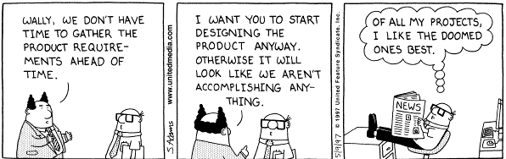
Dilbert: Scott Adams

Slide 41
Classical Waterfall Model
Feasibility Study
Req. Analysis
Design
Design
Coding
Testing
Maintenance

Slide 42
Design
During design phase requirements specification is transformed into :
  A form suitable for implementation in some programming language.

Slide 43
Design
In technical terms:
  During design phase, software architecture is defined.
Two commonly used design approaches:
  Traditional approach,
  Object oriented approach.

Slide 44
Traditional Design Approach
Consists of two activities:
  Structured analysis
  Structured design

Slide 45
Structured Analysis (CONT.)‏
Carried out using Data flow diagrams (DFDs).
After structured analysis, carry out structured design:
  architectural design (or high-level design)‏
  detailed design (or low-level design).

Slide 46
Structured Design
High-level design:
  decompose the system into modules,
  represent invocation relationships among the modules.
Detailed design:
  different modules designed in greater detail:
    data structures and algorithms for each module are designed.

Slide 47
Object-Oriented Design
First identify various objects (real world entities) occurring in the problem:
  Identify the relationships among objects.
  For example, the objects in a pay-roll software may be:
    employees,
    managers,
    pay-roll register,
    Departments, etc.

Slide 48
Object Oriented Design (CONT.)‏
Object structure
  Further refined to obtain the detailed design.
OOD has several advantages:
  Lower development effort,
  Lower development time,
  Better maintainability.

Slide 49
Classical Waterfall Model
Feasibility Study
Req. Analysis
Design
Coding
Coding
Testing
Maintenance

Slide 50
Coding and Unit Testing
During this phase:
  Each module of the design is coded,
  Each module is unit tested
    That is, tested independently as a stand alone unit, and debugged.
  Each module is documented.

Slide 51
Classical Waterfall Model
Feasibility Study
Req. Analysis
Design
Coding
Testing
Testing
Maintenance

Slide 52
Integration and System Testing
Different modules are integrated in a planned manner:
  Modules are usually integrated through a number of steps.
During each integration step,
  the partially integrated system is tested.
M1
M2
M5
M7
M3
M4
M6
M8

Slide 53
System Testing
After all the modules have been successfully integrated and tested:
  System testing is carried out.
Goal of system testing:
  Ensure that the developed system functions according to its requirements as specified in the SRS document.

Slide 54
Classical Waterfall Model
Feasibility Study
Req. Analysis
Design
Coding
Testing
Maintenance
Maintenance

Slide 55
Maintenance
Maintenance of any software:
  Requires much more effort than the effort to develop the product itself.
  Development effort to maintenance effort is typically 40:60.

Slide 56
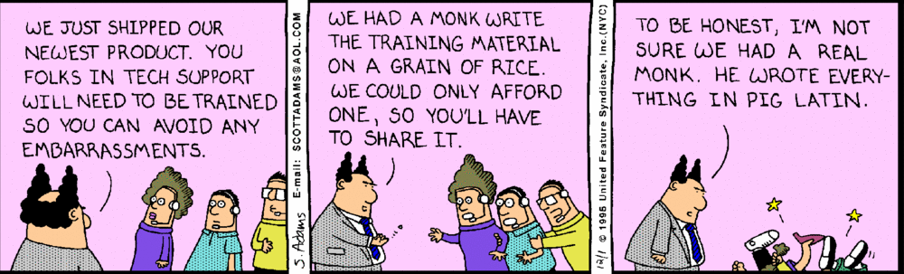
Dilbert: Scott Adams

Slide 57
Types of Maintenance?
Corrective maintenance:
  Correct errors which were not discovered during the product development phases.
Perfective maintenance:
  Improve implementation of the system
  enhance functionalities of the system.
Adaptive maintenance:
  Port software to a new environment,
    e.g. to a new computer or to a new operating system.

Slide 58
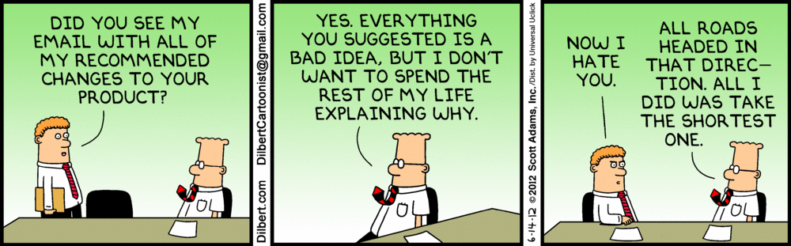

Slide 59
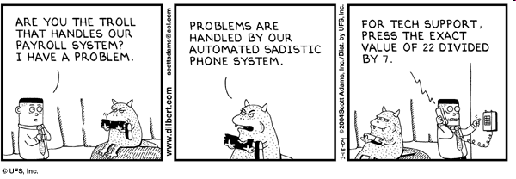
Dilbert: Scott Adams

Slide 60
Iterative Waterfall Model
Classical waterfall model is idealistic:
  Assumes that no defect is introduced during any development activity.
  In practice:
    Defects do get introduced in almost every phase of the life cycle.

Slide 61
Iterative Waterfall Model (CONT.)‏
Defects usually get detected much later in the life cycle:
  For example, a design defect might go unnoticed till the coding or testing phase.
  The later the phase in which the defect gets detected, the more expensive is its removal --- why?

Slide 62
Iterative Waterfall Model (CONT.)‏
Once a defect is detected:
  The phase in which it occurred needs to be reworked.
  Redo some of the work done during that and all subsequent phases.
Therefore need feedback paths in the classical waterfall model.

Slide 63
Iterative Waterfall Model (CONT.)‏
Feasibility Study
Req. Analysis
Design
Coding
Testing
Maintenance

Slide 64
Phase Containment of Errors
(Cont...)‏
Errors should be detected:
  In the same phase in which they are introduced.
For example:
  If a design problem is detected in the design phase itself,
    The problem can be taken care of much more easily
    Than say if it is identified at the end of the integration and system testing phase.

Slide 65
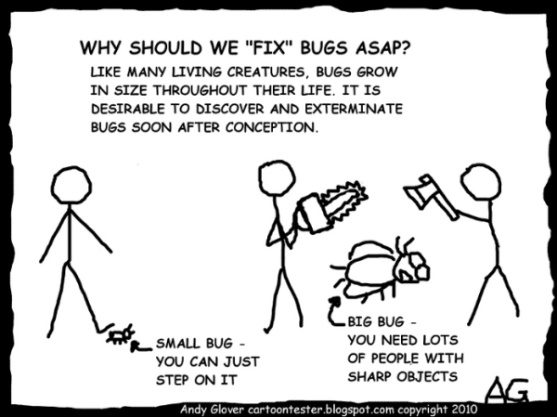
Cartoonist’s View…
Grows over Lifecycle…

Slide 66
Phase Containment of Errors
Reason: rework must be carried out not only to the design but also to code and test phases.
The principle of detecting errors as close to its point of introduction as possible:
  is known as phase containment of errors.
Iterative waterfall model is by far the most widely used model.
  Almost every other model is derived from the waterfall model.

Slide 67
Waterfall Strengths
Easy to understand, easy to use
Provides a reference to inexperienced staff
Milestones are well understood by the team
Provides requirements stability
Facilitates strong management control (plan, staff, track)

Slide 68
Waterfall Deficiencies
All requirements must be known upfront
Deliverables created for each phase are considered frozen – inhibits flexibility
Can give a false impression of progress
Integration is one big bang at the end
Little opportunity for customer to pre-view the system.

Slide 69
When to use the Waterfall Model?
Requirements are well known and stable
Technology is understood
Experienced Development team

Slide 70
Classical Waterfall Model (CONT.)‏
Irrespective of the life cycle model actually followed:
  The documents should reflect a classical waterfall model of development,
  Comprehension of the documents is facilitated.

Slide 71
Classical Waterfall Model (CONT.)‏
Metaphor of mathematical theorem proving:
  A mathematician presents a proof as a single chain of deductions,
    Even though the proof might have come from a convoluted set of partial attempts, blind alleys and backtracks.

Slide 72
Quiz
What problems may be encountered if a project manager recommends use of the iterative waterfall model for a customization project?
Give one example project situation for which waterfall model is suitable.
Give one example project situation for which waterfall model is not suitable.
What is a milestone? Give one example of a milestone.
In what way are milestones useful?
How frequently should milestones be placed?

Slide 73
Quiz
Suppose the sales manager of your company informs the top management of your company that he sees tremendous potential for a wearable health monitor:
  The wearable health monitor would measure vital body parameters such as heart rate, temperature, blood pressure, etc and maintain a log.
How would you perform feasibility study?

Slide 74
V Model

Slide 75
V Model
It is a variant of the Waterfall
  emphasizes verification and validation
  V&V activities are spread over the entire life cycle.
In every phase of development:
  Testing activities are planned in parallel with development.

Slide 76
Project&
Requirements
Planning
Production,
Operation &
Maintenance
Product
Requirements&
Specification
Analysis
System&
Acceptance
Testing
Architecture
High Level
Design
Integration&
Testing
Detailed Design
Unit testing
Coding

Slide 77
V Model Steps
Planning
Requirements Specification and Analysis
Design
Coding
System and acceptance testing
Integration and Testing
Unit testing

Slide 78
V Model: Strengths
Starting from early stages of software development:
  Emphasize planning for verification and validation of the software
Each deliverable is made testable
Easy to use

Slide 79
V Model Weaknesses
Does not support overlapping of phases
Does not handle iterations or phases
Does not easily handle later changes in requirements
Does not support risk analysis activities

Slide 80
When to use V Model
Natural choice for systems requiring high reliability:
  Embedded control applications
All requirements are known up-front
Solution and technology are known

Slide 81
Prototyping Model

Slide 82
Prototyping Model
A derivative of waterfall model.
Before starting actual development,
  A working prototype of the system should first be built.
A prototype is a toy implementation of a system:
  Limited functional capabilities,
  Low reliability,
  Inefficient performance.

Slide 83
Reasons for prototyping
learning by doing: useful where requirements are only partially known
improved communication
improved user involvement
reduces the need for documentation
reduces maintenance costs i.e. changes after the application goes live
Notes:
A prototype is a working model of one or more aspects of the project application. It is constructed quickly and inexpensively in order to test out assumptions.
Sections 4.9, 4.10 and 4.11 discuss this topic.
learning by doing - useful where requirements are only partially known
improved communication - users are reluctant to read massive documents, but when system is ‘live’ you get a better feeling for it
improved user involvement - user ideas and requests are quickly implemented
the reduction of maintenance costs – the idea is that if you do not have a prototype then the first release of the application will effectively become a prototype as users will find things that they do not like and then ask for them to be changed. It is easier and safer to make such changes before the application becomes operational.
testing - involves devising test cases and then documenting the results expected when the test cases are run. If these are done by hand, then effectively you have a manual prototype. Why not get the software prototype to generate the expected results?

Slide 84
Reasons for Developing a Prototype
Illustrate to the customer:
  input data formats, messages, reports, or interactive dialogs.
Examine technical issues associated with product development:
  Often major design decisions depend on issues like:
    Response time of a hardware controller,
    Efficiency of a sorting algorithm, etc.

Slide 85
Prototyping Model (CONT.)‏
Another reason for developing a prototype:
  It is impossible to “get it right” the first time,
  We must plan to throw away the first version:
    If we want to develop a good software.

Slide 86
Prototyping Model (CONT.)‏
Start with approximate requirements.
Carry out a quick design.
Prototype model is built using several short-cuts:
  Short-cuts might involve:
    Using inefficient, inaccurate, or dummy functions.
    A table look-up rather than performing the actual computations.

Slide 87
Prototyping Model (CONT.)‏
The developed prototype is submitted to the customer for his evaluation:
  Based on the user feedback, the prototype is refined.
  This cycle continues until the user approves the prototype.
The actual system is developed using the waterfall approach.

Slide 88
Prototyping Model (CONT.)‏
Build Prototype
Requirements
Gathering
Customer Evaluation of Prototype
Customer
satisfied
Quick Design
Design
Refine Requirements
Implement
Test
Maintain

Slide 89
Prototyping Model (CONT.)‏
Requirements analysis and specification phase becomes redundant:
  Final working prototype (incorporating all user feedbacks) serves as an animated requirements specification.
Design and code for the prototype is usually thrown away:
  However, experience gathered from developing the prototype helps a great deal while developing the actual software.

Slide 90
Prototyping Model (CONT.)‏
Even though construction of a working prototype model involves additional cost --- overall development cost might be lower for:
  Systems with unclear user requirements,
  Systems with unresolved technical issues.
Many user requirements get properly defined and technical issues get resolved:
  These would have appeared later as change requests and resulted in incurring massive redesign costs.

Slide 91
Prototyping: advantages
The resulting software: more usable
User needs are better accommodated
The design is of higher quality
The resulting software is easier to maintain
Overall, the development incurs less effort
SE, Software Lifecycle, Hans van Vliet, ©2008
Notes:
© SE, Lifecycle, Hans van Vliet

Slide 92
Prototyping: disadvantages
Sometimes expensive
Susceptible to over-engineering:
  Designers start to incorporate sophistications that they could not incorporate in the prototype.
SE, Software Lifecycle, Hans van Vliet, ©2008
Notes:
© SE, Lifecycle, Hans van Vliet
Not that some entries on these lists are the same, I.e. some things are listed as both an advantage and as a disadvantage.

Slide 93
Major difficulties of Waterfall-Based Models
Difficulty in accommodating change requests during development.
  40% of requirements change during development
High cost incurred in developing custom applications.
“Heavy weight processes.”

Slide 94
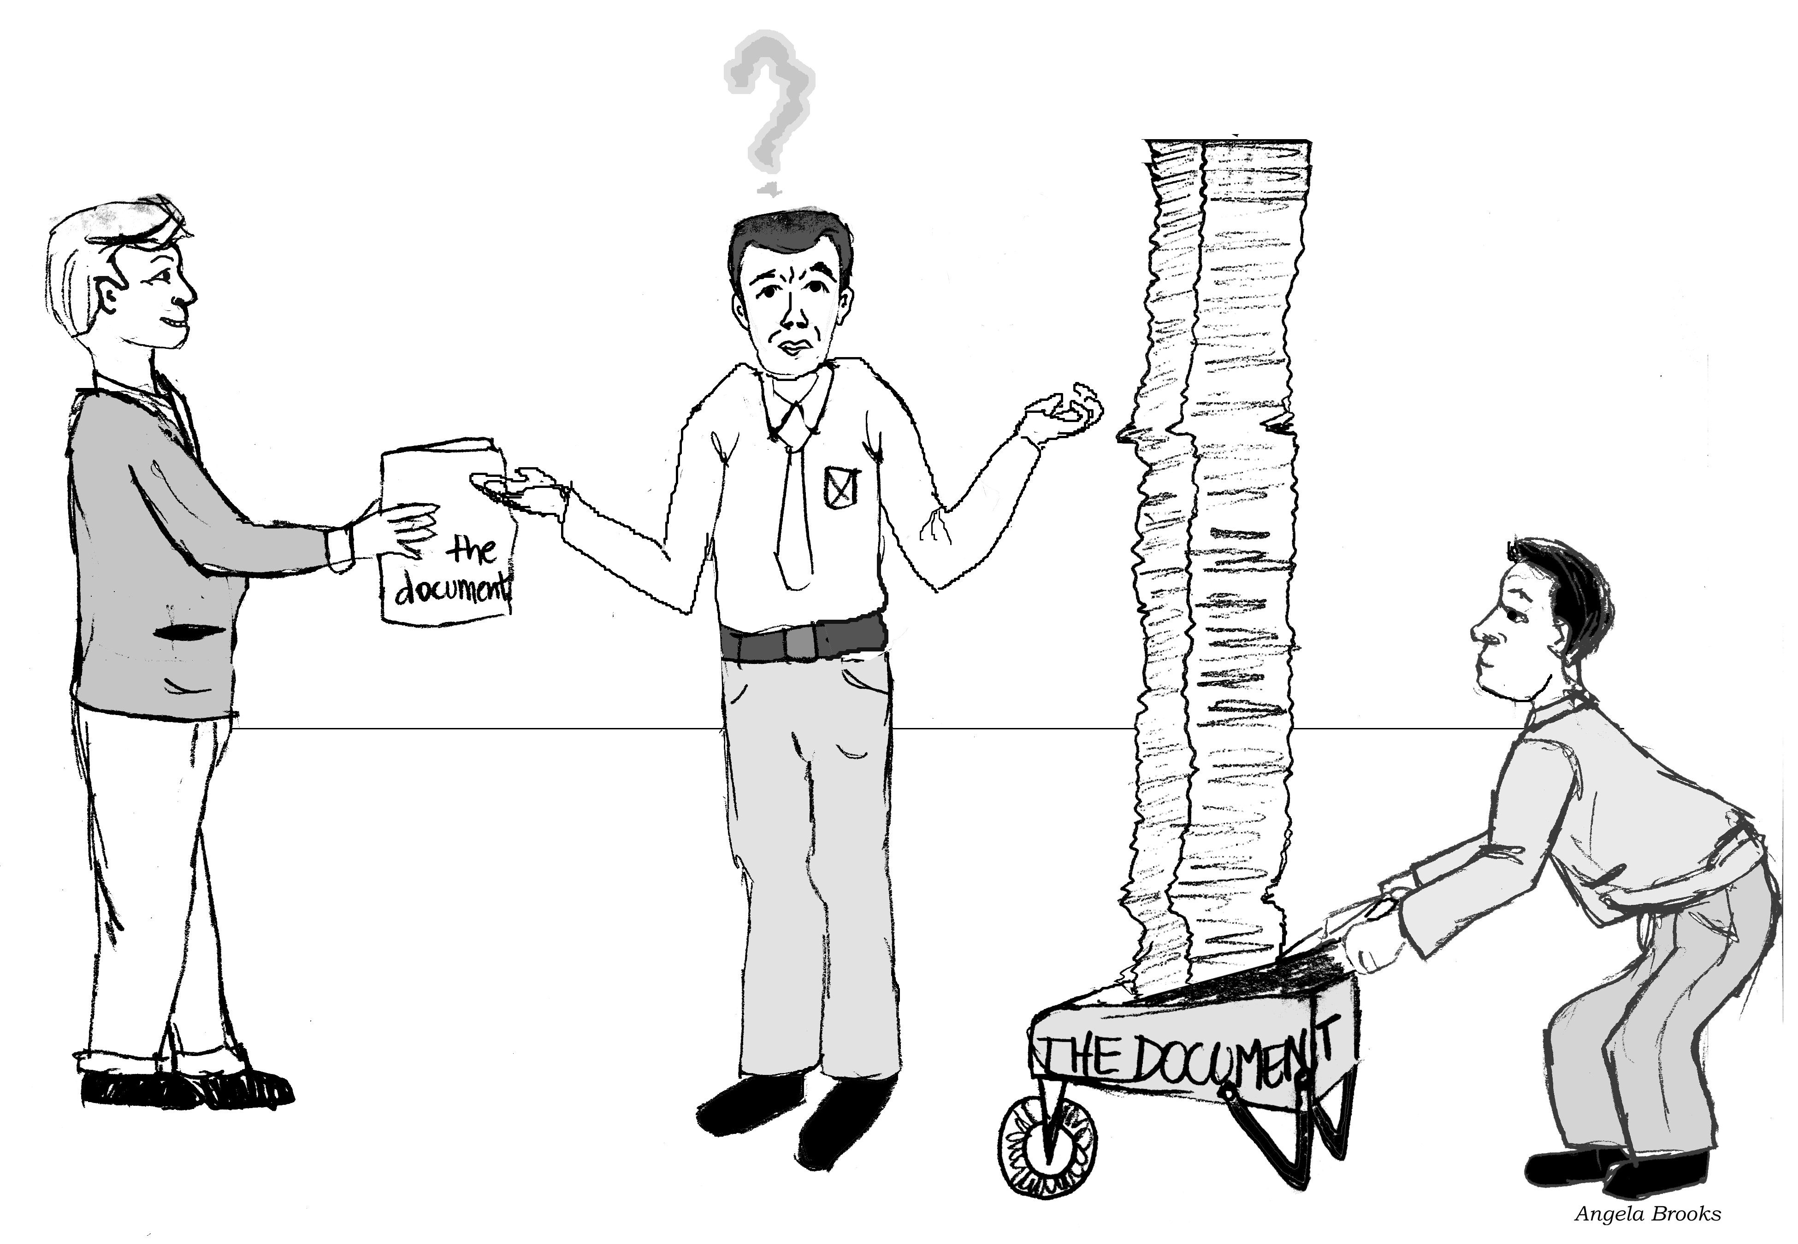
Source: Robert Martin
Documentation.

Slide 95
Major difficulties of Waterfall-Based Life Cycle Models
Requirements for the system are determined at the start:
  Are assumed to be fixed from that point on.
  Long term planning is made based on this.

Slide 96
“… the assumption that one can specify a satisfactory system in advance, get bids for its construction, have it built, and install it. …this assumption is fundamentally wrong and many software acquisition problems spring from this…” Frederick Brooks

Slide 97
Evolutionary Model

Slide 98
Evolutionary Model
Evolutionary model (aka successive versions or incremental model):
  The system is broken down into several modules which can be incrementally implemented and delivered.
First develop the core modules of the software.
The initial skeletal software is refined into increasing levels of capability:
  By adding new functionalities in successive versions.

Slide 99
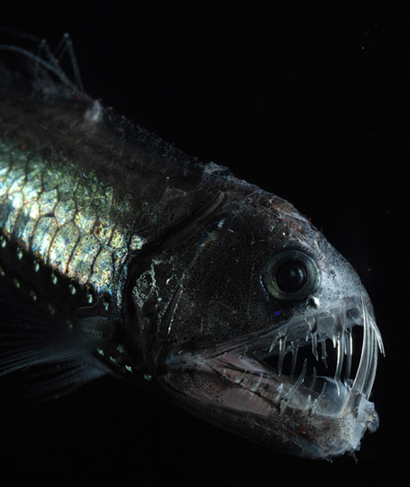
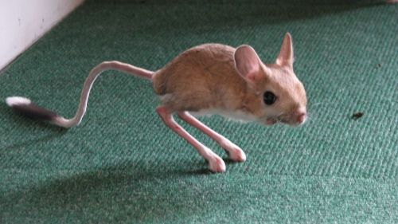



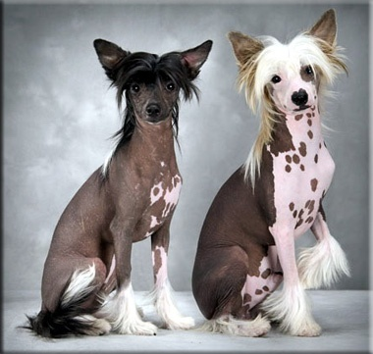
Biological Systems
Notes:
South African armadillo girdled lizard
Chinese crested dog
Platypus
18th century engraving. The artist did see the real animal. This engraving was based on a verbal description.
Long-eared Jerboa
deep ocean viperfish

Slide 100
Biological Systems
The waterfall model did not apply to biological systems --- these evolved instead of being designed.
A complex system that works is invariably found to have evolved from a simple system that worked.
© 2009 Bahill
Notes:
South African armadillo girdled lizard
Chinese crested dog
Platypus
18th century engraving. The artist did see the real animal. This engraving was based on a verbal description.
Long-eared Jerboa
deep ocean viperfish

Slide 101
Evolutionary Model
“A complex system will be most successful if implemented in small steps… “retreat” to a previous successful step on failure… opportunity to receive some feedback from the real world before throwing in all resources… and you can correct possible errors…” Tom Glib in Software Metrics

Slide 102
Evolutionary Model (CONT.)‏
Successive version of the product:
  functioning systems capable of performing some useful work.
  A new release may include new functionality:
    Also existing functionality in the current release might have been enhanced.

Slide 103
Evolutionary Model
Evolves an initial implementation with user feedback:
  Multiple versions until the final version.
Initial
version
Specification
Outline
description
Intermediate
versions
Development
Final
version
Validation

Slide 104
Advantages of Evolutionary Model (1)
Users get a chance to experiment with a partially developed system:
  Much before the full working version is released,
Helps finding exact user requirements:
  Much before fully working system is developed.
Core modules get tested thoroughly:
  Reduces chances of errors in final product.

Slide 105
Advantages of Evolutionary Model (2)
Customers involved in the process:
  Therefore more likely to meet the user requirement.
Early and frequent testing:
  More likely to identify problems.

Slide 106
Evolutionary Model: Problems
The process is intangible:
  No regular, well-defined deliverables.
The process is unpredictable:
  Hard to manage, e.g., scheduling, workforce allocation, etc.
Systems are poorly structured:
  Continual, unpredictable changes tend to degrade the software structure.
Systems may not even converge to a final version.

Slide 107
Incremental Model

Slide 108
Customer’s Perspective‏
C
A
A
A
B
B
B

Slide 109
Incremental Model
Combines the ideas from Waterfall and Evolutionary Model.
Requirements
Outline
Split into
Requirements
Design
Develop
Increment
Validate
Increment
Integrate
Increment
Validate
System
Final System

Slide 110
Incremental Model
High Level Analysis
Slice
Slice
Slice
Slice
Slice
Slice
Slice
Slice
Slice
Slice
Slice
Slice

Slide 111
Incremental Model
Waterfall: single release
Iterative: many releases (increments)
  First increment: core functionality
  Successive increments: add/fix functionality
  Final increment: the complete product
Each iteration: a short mini-project with
a separate lifecycle
  e.g., waterfall

Slide 112



Incremental delivery
delivered
system
increment
1
first incremental delivery
increment
2
second incremental delivery
increment
3
third incremental delivery
Notes:
The application to be delivered is broken down into a number of components each of which will be actually used by the users. Each of these is then developed as a separate ‘mini-project’ or increment.

Slide 113
The incremental process
Planned
incremental
delivery
Identify System Objectives
Plan increments
Incremental delivery plan
Design increment
Build the increment
Feedback
Repeat for each increment
Implement the increment
Evaluate the results

Slide 114
Waterfall
R
D
C
T
One Iteration
R
R
D
Evolutionary Model With Iteration
R
D
C
R
D
T
C
D
C
T
C
T
T
Time
R:Requirement Analysis
D:Design
C:Coding, Unit Testing
T:Integration, Test

Slide 115
Which step first?
Some steps will be pre-requisite because of physical dependencies
Others may be in any order
Value to cost ratios may be used
  V/C where
  V is a score 1-10 representing value to customer
  C is a score 0-10 representing cost to developers

Slide 116
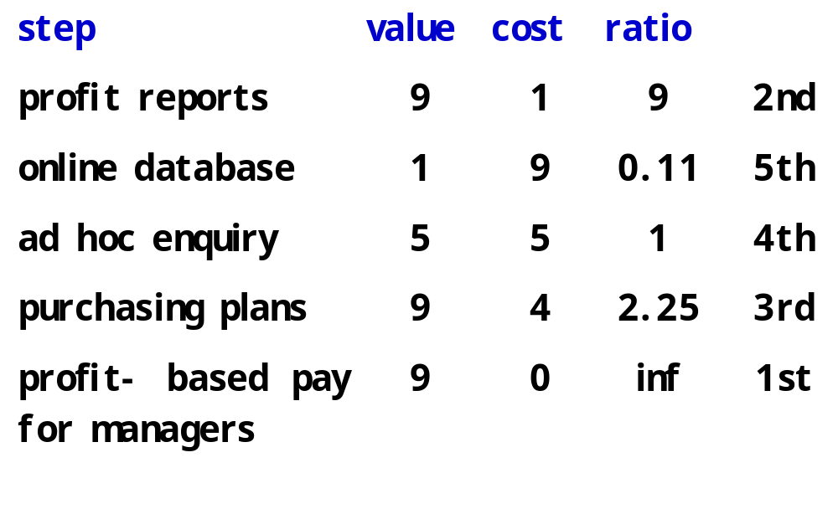
V/C ratios: an example

Slide 117
Incremental and Iterative Development (IID) Model

Slide 118
“The basic idea… take advantage of what was being learned during the development of earlier, incremental, deliverable versions of the system. Learning comes from both the development and use of the system… Start with a simple implementation of a subset of the software requirements and iteratively enhance the evolving sequence of versions. At each version design modifications are made along with adding new functional capabilities. “ Victor Basili

Slide 119
Incremental and Iterative Development (IID)
Key characteristics
  Consists of a planned number of iterations
  Each iteration produces a working program
  Builds system incrementally
  ⬄ Monolithic approach of waterfall model
Benefits
  Facilitates and manages changes
Foundation of agile techniques
  Rational Unified Process (RUP)
  Extreme Programming (XP)

Slide 120
Evolutionary Model with Iteration
Outcome of each iteration: tested, integrated, executable system
Iteration length is short and fixed
  e.g. 2 weeks, 4 weeks, 6 weeks
  Takes many iterations (e.g. 10-15)
Does not “freeze” the requirements and then speculatively design :
  Opportunity exists to modify requirements as well as the design…
  Later iterations become stable

Slide 121
Advantages of evolutionary model with iteration?
Can better manage complexity by developing one increment at a time.
Can better manage changing requirements.
Can provide partial solutions throughout the development process.
Can get customer feedback and incorporate them much more efficiently:
  As compared when customer feedbacks come only after all development is complete.

Slide 122
Advantages of Evolutionary Model with Iteration
Training can start on an earlier release
  customer feedback taken into account
Markets can be created:
  For functionality that has never been offered by other vendors.
Frequent releases allow developers to fix unanticipated problems quickly.

Slide 123
Incremental versus Evolutionary
Evolutionary iterative development implies that the requirements, plan, estimates, and solution evolve or are refined over the course of the iterations, rather than fully defined and “frozen” in a major up-front specification effort before the development iterations begin. Evolutionary methods are consistent with the pattern of unpredictable discovery and change in new product development.” Craig Larman

Slide 124
RAD Model

Slide 125
Rapid Application Development (RAD) Model
Sometimes referred to as the rapid prototyping model.
Major aims:
  Decrease the time taken and the cost incurred to develop software systems.
  Facilitate accommodating change requests as early as possible:
    Before large investments have been made in development and testing.

Slide 126
Important Underlying Principle
A way to reduce development time and cost, and yet have flexibility to incorporate changes:
  Make only short term plans and make heavy reuse of existing code.

Slide 127
Methodology
Plans are made for one increment at a time.
  The time planned for each iteration is called a time box.
Each iteration (increment):
  Enhances the implemented functionality of the application a little.

Slide 128
Methodology
During each iteration,
  A quick-and-dirty prototype-style software for some functionality is developed.
  The customer evaluates the prototype and gives his feedback.
  The prototype is refined based on the customer feedback.

Slide 129
How Does RAD Facilitate Faster Development?
RAD achieves fast creation of working prototypes.
  Through use of specialized tools.
These specialized tools usually support the following features:
  Visual style of development.
  Use of reusable components.
  Use of standard APIs (Application Program Interfaces).

Slide 130
Applications for Which RAD is Suitable
Customized product developed for one or two customers only
Performance and reliability are not critical.
The system can be split into several independent modules.

Slide 131
Application Characteristics that Render RAD Unsuitable
Few plug-in components are available
High performance or reliability required
No precedence for similar products exists
The system cannot be modularized.

Slide 132
Prototyping versus RAD
In prototyping model:
    The developed prototype is primarily used to gain insights into the solution
    Choose between alternatives
    Elicit customer feedback.
  The developed prototype:
    Usually thrown away.

Slide 133
Prototyping versus RAD
In contrast:
  In RAD the developed prototype evolves into deliverable software.
RAD leads to faster development compared to traditional models:
  However, the quality and reliability would possibly be poorer.

Slide 134
RAD versus Iterative Waterfall Model
In the iterative waterfall model,
  All product functionalities are developed together.
In the RAD model on the other hand,
  Product functionalities are developed incrementally through heavy code and design reuse.
  Customer feedback is obtained on the developed prototype after each iteration:
    Based on this the prototype is refined.

Slide 135
RAD versus Iterative Waterfall Model
The iterative waterfall model:
  Does not facilitate accommodating requirement change requests.
Iterative waterfall model does have some important advantages:
  Use of the iterative waterfall model leads to production of good documentation.
  Also, the developed software usually has better quality and reliability than that developed using RAD.
  .

Slide 136
RAD versus Evolutionary Model
Incremental development:
  Occurs in both evolutionary and RAD models.
However, in RAD:
  Each increment is a quick and dirty prototype,
  Whereas in the evolutionary model each increment is systematically developed using the iterative waterfall model.
Also, RAD develops software in shorter increments:
  Compared to the evolutionary model
  The incremental functionalities are fairly large in the evolutionary model.
  .

Slide 137
Agile Models

Slide 138
What is Agile Software Development?
Agile: Easily moved, light, nimble, active software processes
How agility achieved?
  Fitting the process to the project
  Avoidance of things that waste time
Notes:
Agile SE -> Agile SD
How many have heard of Agile Software Development?
What does the word Agile mean? Anyone?
Latin word agilis, which means “easily moved, light, nimble, active”.
3. Agile Software development – defined as easily moved, light, nimble, and active software processes.
(Agile processes are not unique to software development. They appeared in mainstream business literature in 1991 in the form of Agile manufacturing.)
4. Fitting the process… Not project to the process.
Battlefield commanders plan extensively when going to war -> but realize that their plans are just the beginning. Creating and responding to change are very important.
Success is defined by accomplishing the mission (defeating the enemy) not conforming to the plan.
Can you image a commander saying, “We lost the battle but by golly we were successful because we followed our plan to the letter.”
Or “If we just plan this battle long and hard enough, and put repeatable processes in place, we can eliminate change early and not have to deal with it later.”
Pretty unreasonable.

Slide 139
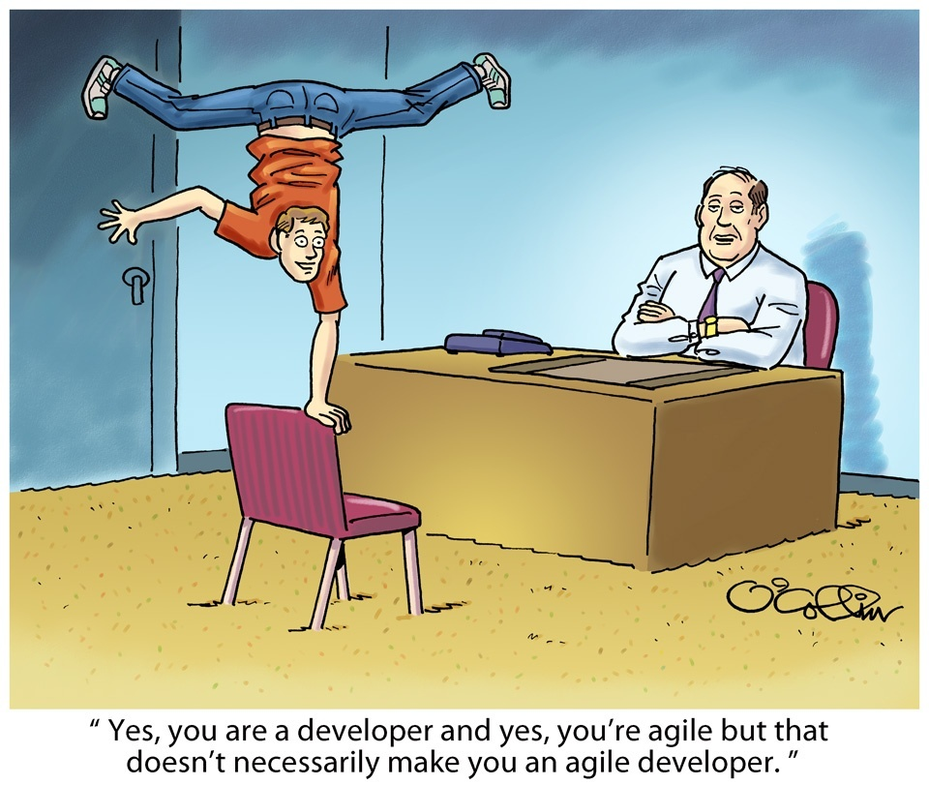
Cartoonist’s View: Agile Model

Slide 140
Agile Model
To overcome the shortcomings of the waterfall model of development.
  Proposed in mid-1990s
The agile model was primarily designed:
  To help a project to adapt to change requests
In the agile model:
  The requirements are decomposed into many small incremental parts that can be developed over one to four weeks each.

Slide 141
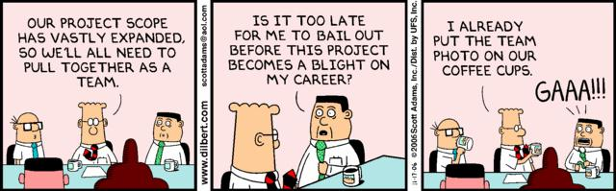

Slide 142
What is Agile Software Development?
Agile: Easily moved, light, nimble, active software processes
How agility achieved?
  Fitting the process to the project
  Avoidance of things that waste time
Notes:
Agile SE -> Agile SD
How many have heard of Agile Software Development?
What does the word Agile mean? Anyone?
Latin word agilis, which means “easily moved, light, nimble, active”.
3. Agile Software development – defined as easily moved, light, nimble, and active software processes.
(Agile processes are not unique to software development. They appeared in mainstream business literature in 1991 in the form of Agile manufacturing.)
4. Fitting the process… Not project to the process.
Battlefield commanders plan extensively when going to war -> but realize that their plans are just the beginning. Creating and responding to change are very important.
Success is defined by accomplishing the mission (defeating the enemy) not conforming to the plan.
Can you image a commander saying, “We lost the battle but by golly we were successful because we followed our plan to the letter.”
Or “If we just plan this battle long and hard enough, and put repeatable processes in place, we can eliminate change early and not have to deal with it later.”
Pretty unreasonable.

Slide 143
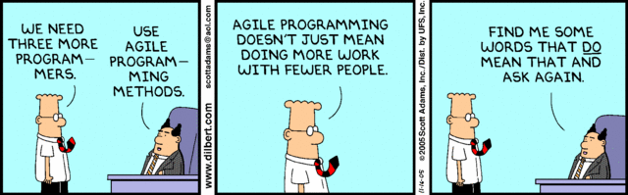
Dilbert: Scott Adams

Slide 144
Ideology: Agile Manifesto
Individuals and interactions over
  process and tools
Working Software over
  comprehensive documentation
Customer collaboration over
  contract negotiation
Responding to change over
  following a plan
http://www.agilemanifesto.org
Notes:
Idealisms
Over instead of versus is because they are all good ideals
Rework vs. Reuse – everything should be production quality, but reworkable for flexibility. Don’t be afraid of partial solutions.
Military Adoption of the 80% solution.
Responding to Change – in line with Lucy Suchman’s Plans and Situated Actions, with the trukese and european navigators.

Slide 145
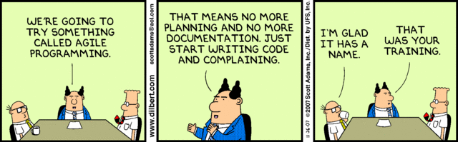
Dilbert: Scott Adams

Slide 146
Agile Methodologies
XP
Scrum
Unified process
Crystal
DSDM
Lean

Slide 147
Agile Model: Principal Techniques
User stories:
  Simpler than use cases.
Metaphors:
  Based on user stories, developers propose a common vision of what is required.
Spike:
  A very simple program to explore potential solutions should be considered.
Refactor:
  Restructure code without affecting behavior, improve efficiency, structure, etc.

Slide 148
Agile Model: Nitty Gritty
At a time, only one increment is planned, developed, deployed at the customer site.
  No long-term plans are made.
An iteration may not add significant functionality,
  but still a new release is invariably made at the end of each iteration
  Delivered to the customer for regular use.

Slide 149
Methodology
Face-to-face communication favoured over written documents.
To facilitate face-to-face communication,
  development team to share a single office space.
  Team size is deliberately kept small (5-9 people)
  This makes the agile model most suited to the development of small projects.

Slide 150
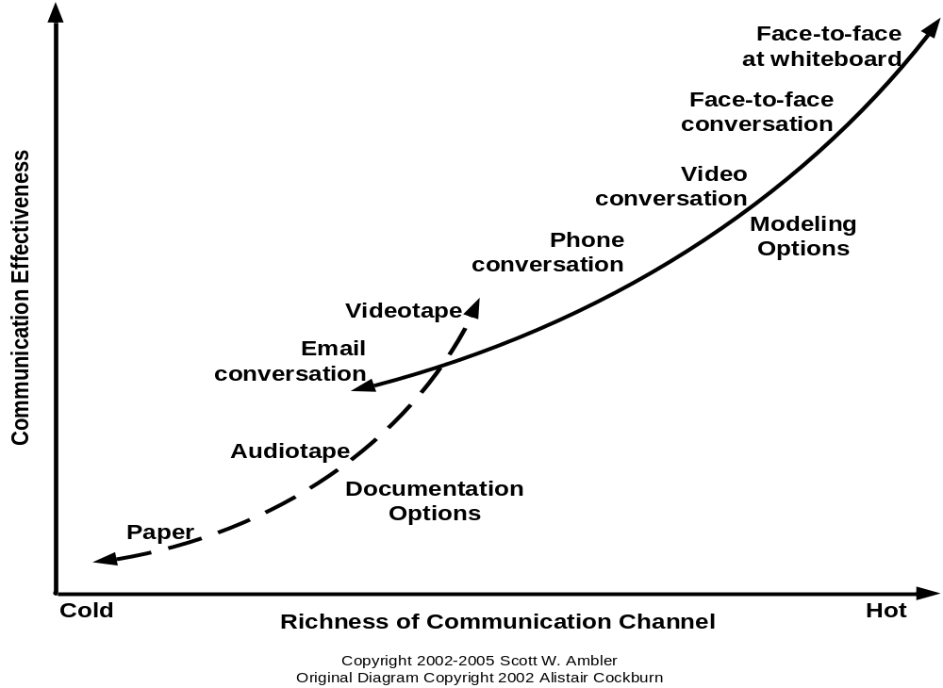
Effectiveness of Communication Modes
Notes:
Software development is a communication game
Documentation is the worst way to communicate
Whatever your situation, use the most effective means at your disposal to communicate
http://www.agilemodeling.com/essays/communication.htm

Slide 151
Agile Model: Principles
The primary measure of progress:
  Incremental release of working software
Important principles behind agile model:
  Frequent delivery of versions every few weeks.
  All change requests to the requirements are accommodated easily.
  Close cooperation between customers and developers.
  Face-to-face communication among the development team members.

Slide 152
Agile Documentation
Travel light:
  You need far less documentation than you think.
Agile documents:
  Are concise
  Describe information that is less likely to change
  Describe “good things to know”
  Are sufficiently accurate, consistent, and detailed
Valid reasons to document:
  Your project stakeholders require it
  To define a contract model
  To support communication with an external group
  To think something through

Slide 153
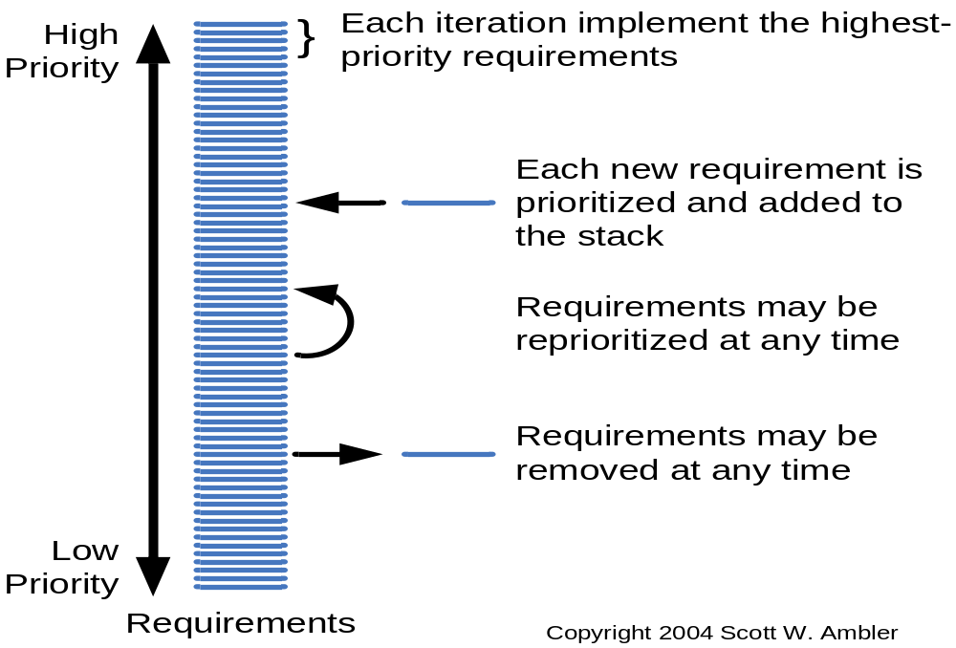
Agile Software Requirements Management

Slide 154
Adoption Detractors
Lack of theoretical grounding
  Inconsistent and diverse definitions
High quality people skills required
Short iterations inhibit long-term perspective
Higher risks:
  Harder to manage feature creep and customer expectations
  Difficult to quantify cost, time, quality.
Notes:
Why not more adoption (in SE? in corporate? In universities?)
Inconsistent and diverse defs – need more quality methodology not just quantity.
Lack of Theoretical Grounding – current concept of agility based on experience, not on underlying concepts like flexibility and leanness. Agile methods like SCRUM and XP are derived from subjective practical experience and not reliable systematic research.
But there is hope… Conboy et. Al. and their framework of agility for software development (based on underlying concepts);
Role changes – management role less prominent and active, more like a coach
Situational customization – no out of the box operation. Takes time to customize a process and get good at it.
Difficult to quantify – Agile practices are more philosophy based not activity based.
Risks – Making the customer understand the tradeoffs for following them down a rabbit hole can be difficult.
How do you budget a project if you can’t get the all/most requirements upfront?

Slide 155
Agile Model Shortcomings
Derive agility through developing tacit knowledge in the team, rather than any formal document:
  Can be misinterpreted…
  External review difficult to get…
  When project is complete, and team disperses, maintenance becomes difficult…

Slide 156
Agile vs. Plan-Driven Processes
Small products and teams:
  Scalability limited
Untested on safety-critical products
Good for dynamic, but expensive for stable environments.
Require experienced personnel throughout
Personnel thrive on freedom and chaos
Large products and teams;
  hard to scale down
Proven for highly critical products;
Good for stable:
  But expensive for dynamic environments
Require only few experienced personnel
Personnel thrive on structure and order
Notes:
Good for dynamic.. - Simple design and refactoring principles
Boehm and Turner propose these risk factors based on observation, not from experience.

Slide 157
Agile Model versus Iterative Waterfall Model
The waterfall model steps through in a planned sequence over
  Requirements-capture, analysis, design, coding, and testing stages:
Progress is measured in terms of delivered artifacts:
  Requirement specifications, design documents, test plans, code reviews, etc.
In contrast agile model sequences:
  Delivery of working versions of a product in several increments.

Slide 158
Agile Model versus Iterative Waterfall Model
As regards to similarity:
  We can say that Agile teams use the waterfall model on a small scale.

Slide 159
Agile versus RAD Model
Agile model does not recommend developing prototypes:
  Systematic development of each incremental feature is emphasized.
In contrast:
  RAD is based on designing quick-and-dirty prototypes, which are then refined into production quality code.
Agile projects logically break down the solution into a number of features:
  These are incrementally developed and delivered.

Slide 160
Agile versus exploratory programming
Similarity:
  Frequent re-evaluation of plans,
  Emphasis on face-to-face communication,
  Relatively sparse use of documents.
Agile teams, however, do follow defined and disciplined processes and carry out rigorous designs:
  This is in contrast to chaotic coding in exploratory programming.

Slide 161
Extreme Programming and Unified Process

Slide 162
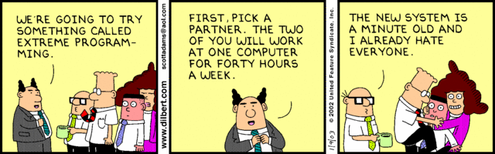
Extreme Programming
Dilbert: Scott Adams

Slide 163
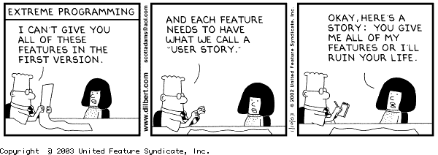
Extreme Programming
Dilbert: Scott Adams

Slide 164
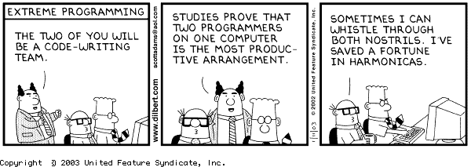
Extremely Programming: Con
Dilbert: Scott Adams

Slide 165
Extreme Programming Model
Extreme programming (XP) was proposed by Kent Beck in 1999.
The methodology got its name from the fact that:
  Recommends taking the best practices to extreme levels.
  If something is good, why not do it all the time.

Slide 166
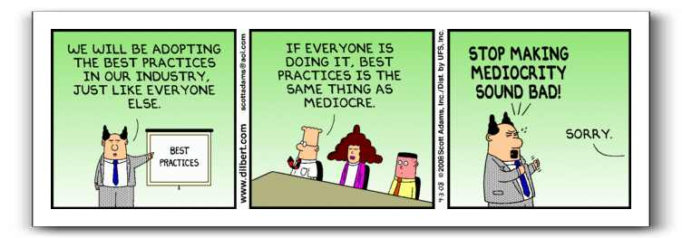
Cartoonist’s View
Dilbert: Scott Adams

Slide 167
4 Values
Communication:
  Enhance communication among team members and with the customers.
Simplicity:
  Build something simple that will work today rather than something that takes time and yet never used
  May not pay attention for tomorrow
Feedback:
  System staying out of users is trouble waiting to happen
Courage:
  Don’t hesitate to discard code

Slide 168
Taking Good Practices to Extreme
If code review is good:
  Always review --- pair programming
If testing is good:
  Continually write and execute test cases --- test-driven development
If incremental development is good:
  Come up with new increments every few days
If simplicity is good:
  Create the simplest design that will support only the currently required functionality.

Slide 169
Taking to Extreme
If design is good,
  everybody will design daily (refactoring)
If architecture is important,
  everybody will work at defining and refining the architecture (metaphor)
If integration testing is important,
  build and integrate test several times a day (continuous integration)

Slide 170
Best Practices
Coding:
  without code it is not possible to have a working system.
  Utmost attention needs to be placed on coding.
Testing:
  Testing is the primary means for developing a fault-free product.
Listening:
  Careful listening to the customers is essential to develop a good quality product.

Slide 171
Best Practices
Designing:
  Without proper design, a system implementation becomes too complex
  The dependencies within the system become too numerous to comprehend.
Feedback:
  Feedback is important in learning customer requirements.

Slide 172
Extreme Programming Activities
XP Planning
  Begins with the creation of “user stories”
  Agile team assesses each story and assigns a cost
  Stories are grouped to for a deliverable increment
  A commitment is made on delivery date
XP Design
  Follows the KIS principle
  Encourage the use of CRC cards
  For difficult design problems, suggests the creation of “spike solutions”—a design prototype
  Encourages “refactoring”—an iterative refinement of the internal program design

Slide 173
Extreme Programming Activities
XP Coding
  Recommends the construction of a unit test for a store before coding commences
  Encourages “pair programming”
XP Testing
  All unit tests are executed daily
  “Acceptance tests” are defined by the customer and executed to assess customer visible functionality

Slide 174
Full List of XP Practices
Planning – determine scope of the next release by combining business priorities and technical estimates
Small releases – put a simple system into production, then release new versions in very short cycle
Metaphor – all development is guided by a simple shared story of how the whole system works
Simple design – system is designed as simply as possible (extra complexity removed as soon as found
Testing – programmers continuously write unit tests; customers write tests for features

Slide 175
Full List of XP Practices
Refactoring – programmers continuously restructure the system without changing its behavior to remove duplication and simplify
Pair-programming -- all production code is written with two programmers at one machine
Collective ownership – anyone can change any code anywhere in the system at any time.
Continuous integration – integrate and build the system many times a day – every time a task is completed.

Slide 176
Full List of XP Practices
40-hour week – work no more than 40 hours a week as a rule
On-site customer – a user is on the team and available full-time to answer questions
Coding standards – programmers write all code in accordance with rules emphasizing communication through the code

Slide 177
Emphasizes Test-Driven Development (TDD)
Based on user story develop test cases
Implement a quick and dirty feature every couple of days:
  Get customer feedback
  Alter if necessary
  Refactor
Take up next feature

Slide 178
Project Characteristics that Suggest Suitability of Extreme Programming
Projects involving new technology or research projects.
  In this case, the requirements change rapidly and unforeseen technical problems need to be resolved.
Small projects:
  These are easily developed using extreme programming.

Slide 179
Rational Unified Process
Originally developed by Rational Software:
  Acquired by IBM in February 2003.
Based on six best practices:
  Develop iteratively, with risk as the primary iteration driver
  Manage requirements
  Employ a component-based architecture
  Model software visually
  Continuously verify quality
  Control changes

Slide 180
An Evolutionary and Iterative Development Process...
Recognizes the reality of changing requirements
  Capers Jones’s research on 8000 projects
    40% of final requirements arrived after development had already begun
Promotes early risk mitigation:
  Breaks down the system into mini-projects and focuses on the riskier elements first.
Allows you to:
  “plan a little, design a little, and code a little”
Encourages all development participants to be involved earlier on,:
  Testers, integrators, and technical writers

Slide 181
Goals and Features of Each Iteration
Primary goal of each iteration:
  Chip away the project risks.
Addresses following risks:
  Performance risks
  Integration risks (different vendors, tools, etc.)
  Conceptual risks (ferret out analysis and design flaws)

Slide 182
Activities in an Iteration
Perform a project of “mini waterfalls”.
The result of a single iteration:
  Ends with delivery of some tangible code
  An incremental improvement to the software --- leads to evolutionary development

Slide 183
Four Phases --- and iterative Development at Every phase
Inception Phase
Elaboration Phase
Construction Phase
Transition Phase

Slide 184
RUP Iterations in Phases
The duration of and iteration may vary from two weeks or less.
Iterations
Iterations
Iterations
Iterations
Inception
Elaboration
Construction
Transition

Slide 185
Unified process
software
increment
inception
Communication
Deployment
Planning
transition
elaboration
Construction
Modeling
construction

Slide 186
Unified process work products
Inception phase
vision document
initial use-case model
initial business case
initial risk list
project plan
prototype(s)
...
Elaboration phase
use-case model
requirements
analysis model
preliminary model
revised risk list
preliminary manual
...
Construction phase
design model
SW components
test plan
test procedure
test cases
user manual
installation manual
...
Transition phase
SW increment
beta test reports
user feedback
...

Slide 187
Structure of RUP Process
Two dimensions.
Horizontal axis:
  Represents time and shows the lifecycle aspects of the process as it unfolds.
Vertical axis:
  Represents core process workflows.

Slide 188
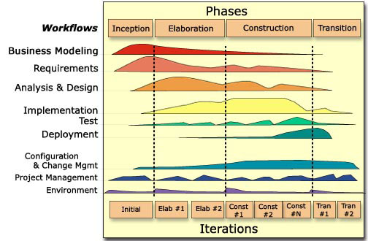
Two dimensions of RUP

Slide 189
Inception activities
Formulate scope of project
Evaluate alternatives for risk management, staffing, project plan
Synthesize a candidate architecture.

Slide 190
Outcome of Inception Phase
Initial requirements capture
Cost Benefit Analysis
Initial Risk Analysis
Project scope definition
Defining a candidate architecture
Development of a disposable prototype
Initial Use Case Model (10% - 20% complete)
First pass at a Domain Model

Slide 191
Elaboration Phase
Requirements Analysis and Capture
  Use Case Analysis
    Use Case Model (80% done)
  Other models:
      Sequence and Collaboration Diagrams
      Class, Activity, Component, State Diagrams
  Glossary (users and developers can speak common vocabulary)
  Domain Model
    Model the system’s requirements as they exist within the context of the problem domain
  Risk Assessment Plan revised
  Architecture Document

Slide 192
Construction Phase
Focus is on implementation of the design:
  The focus is on implementation.
  Most of the coding is done in this phase, and the architecture and design are fully developed.
  Greater stability begins to appear
  Analysis continues, but design and coding predominate

Slide 193
Transition Phase
Beta testing
The users and maintainers of the system are trained on the application.
The tested baseline of the application is transitioned to the user community and deployed for use.

Slide 194
Transition Phase
The transition phase consists of the transfer of the system to the user community
  Includes shipping, installation, training, technical support and maintenance
Development team begins to shrink
Control is moved to maintenance team
Alpha, Beta, and final releases
Integration with existing systems (legacy, existing versions, etc.)

Slide 195
Transition Phase Activities
Beta testing to validate the new system against use expectations.
Parallel operation with the legacy system that the project is replacing
Conversion of operational databases.
Training of users and maintainers.
Rollout of the product to the marketing, distribution and sales teams.
It concludes when the deployment baseline has achieved the completed vision.

Slide 196
Comparison of Different Life Cycle Models
Iterative waterfall model
  Most widely used model.
  But, suitable only for well-understood problems.
Prototype model is suitable for projects not well understood:
  user requirements
  technical aspects

Slide 197
Comparison of Different Life Cycle Models (CONT.)‏
Evolutionary model is suitable for large problems:
  Can be decomposed into a set of modules that can be incrementally implemented,
  Incremental delivery of the system is acceptable to the customer.
The spiral model:
  Suitable for development of technically challenging software products that are subject to several kinds of risks.

Slide 198
Practice Questions
What are the stages of iterative waterfall model?
What are the disadvantages of the iterative waterfall model?
Why has agile model become so popular?
What difficulties might occur if no life cycle model is followed?

Slide 199
Suggest Suitable Life Cycle Model
A software for an academic institution to automate its:
  Course registration and grading
  Fee collection
  Staff salary
  Purchase and store inventory
The software would be developed by tailoring a similar software that was developed for another educational institution:
  70% reuse
  10% new code and 20% modification

Slide 200
Practice Questions
Which types of risks can be better handled using the spiral model compared to the prototyping model?
Which type of process model is suitable for the following projects:
  A customization software
  A payroll software for contract employees that would be add on to an existing payroll software

Slide 201
Practice Questions
Which lifecycle model would you select for the following project which has been awarded to us by a mobile phone vendor:
  A new mobile operating system
  Needs to work well efficiently with 4G systems
  Power usage minimization
  Directly upload backup data on a cloud infrastructure maintained by the mobile phone vendor
  Provides sensing many health parameters of the user and alerting on any abnormality.

Slide 202
Scrum

Slide 203
Scrum: Characteristics
Self-organizing teams
Product progresses in a series of month-long “sprints”
Requirements are captured as items in a list of “product backlog”
No specific engineering practices prescribed
Uses generative rules to create an agile environment for delivering projects
One of the “agile processes”

Slide 204

How Scrum Works?

Slide 205
Sprints
Scrum projects make progress in a series of “sprints”
  Analogous to XP iterations
Target duration is one month
  +/- a week or two
    But, a constant duration leads to a better rhythm
Product is designed, coded, and tested during the sprint

Slide 206
Sequential vs. Overlapping Dev.
Requirements
Design
Code
Test

Slide 207

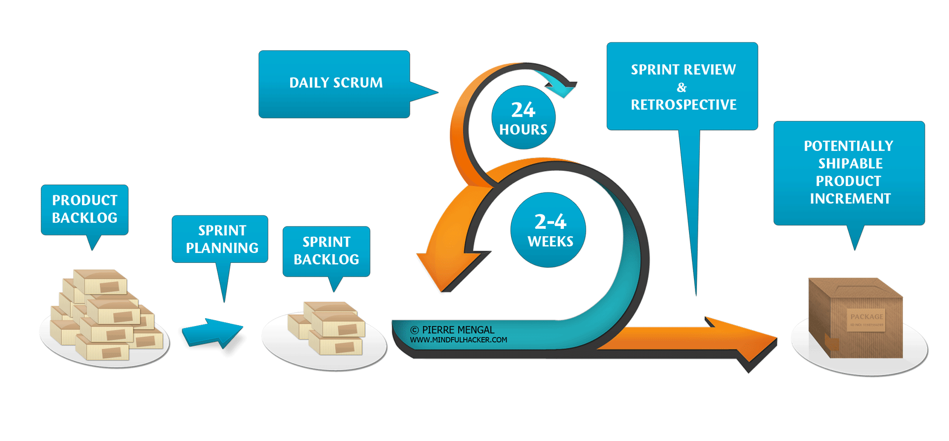

Slide 208
No changes during the sprint
Change
Inputs
Sprint
Tested Code
Plan sprint durations around how long you can commit to keeping change out of the sprint

Slide 209
Scrum Framework
Roles : Product Owner, ScrumMaster, Team
Ceremonies : Sprint Planning, Sprint Review, Sprint Retrospective, & Daily Scrum Meeting
Artifacts : Product Backlog, Sprint Backlog, and Burndown Chart

Slide 210
Key Roles and Responsibilities in Scrum Process
Product Owner
  Acts on behalf of customers to represent their interests.
Development Team
  Team of five-nine people with cross-functional skill sets.
Scrum Master (aka Project Manager)
  Facilitates scrum process and resolves impediments at the team and organization level by acting as a buffer between the team and outside interference.

Slide 211
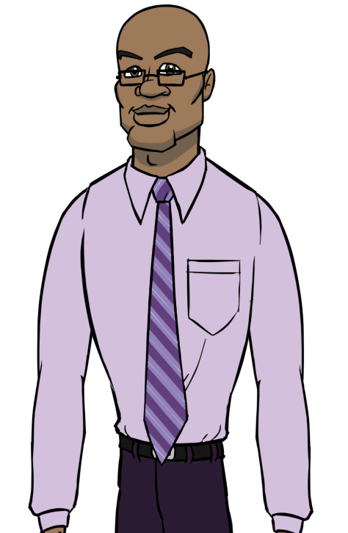
Product Owner
Define the features of the product
Decide on release date and content
Responsible for the profitability of the product (ROI)
Prioritize features according to market value
Adjust features and priority every iteration, as needed
Accept or reject work results.

Slide 212
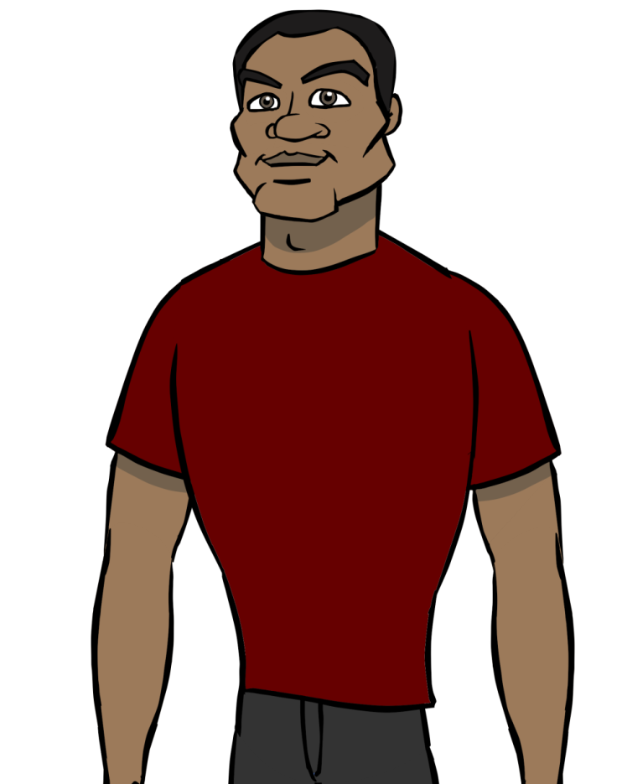
The Scrum Master
Represents management to the project
Responsible for enacting Scrum values and practices
Removes impediments
Ensure that the team is fully functional and productive
Enable close cooperation across all roles and functions
Shield the team from external interferences

Slide 213
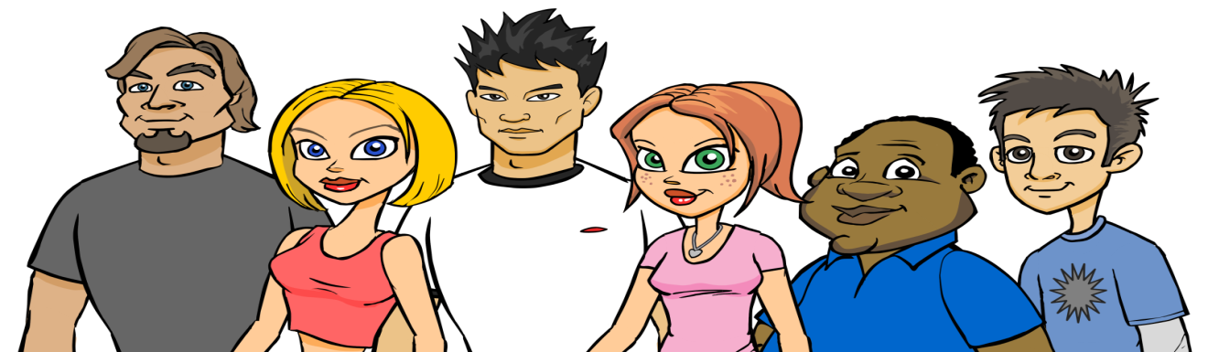
Scrum Team
Typically 5-10 people
Cross-functional
  QA, Programmers, UI Designers, etc.
Members should be full-time
  May be exceptions (e.g., System Admin, etc.)
Teams are self-organizing
  What to do if a team self-organizes someone off the team??
  Ideally, no titles but rarely a possibility
Membership can change only between sprints

Slide 214
Ceremonies
Sprint Planning Meeting
Sprint
Daily Scrum
Sprint Review Meeting

Slide 215
Spring Planning Meeting
Product Owner
Scrum Team
Management
Customers
Product Backlog
Sprint Planning
Meeting
Team Capabilities
Sprint Goal
Business Conditions
Technology
Sprint Backlog
Current Product

Slide 216
Parts of Sprint Planning Meeting
1st Part:
  Creating Product Backlog
  Determining the Sprint Goal.
  Participants: Product Owner, Scrum Master, Scrum Team
2nd Part:
  Participants: Scrum Master, Scrum Team
  Creating Sprint Backlog

Slide 217
Pre-Project/Kickoff Meeting
A special form of Sprint Planning Meeting
Meeting before the begin of the Project

Slide 218
Sprint
Fundamental process flow of Scrum
A short, fixed-length period of time
Goal is to produce Backlog Items into renewable products that Stakeholders can provide feedback on
Sprint Planning allows the PO to work with the Team to negotiate what Backlog Items the Team will work on in order to meet Release Goals
Scrum Master ensures Team agrees to realistic goals

Slide 219
Sprint
A month-long iteration, during which is incremented a product functionality
NO outside influence can interfere with the Scrum team during the Sprint
Each Sprint begins with the Daily Scrum Meeting

Slide 220
Daily Scrum
Parameters
  Daily
  15-minutes
  Stand-up
  Not for problem solving
Three questions:
  What did you do yesterday
  What will you do today?
  What obstacles are in your way?
Chickens and pigs are invited
  Help avoid other unnecessary meetings
Only pigs can talk

Slide 221
Daily Scrum
Is NOT a problem solving session
Is NOT a way to collect information about WHO is behind the schedule
Is a meeting in which team members make commitments to each other and to the Scrum Master
Is a good way for a Scrum Master to track the progress of the Team

Slide 222
Scrum FAQs
Why daily?
  “How does a project get to be a year late?”
    “One day at a time.”
      Fred Brooks, The Mythical Man-Month.
Can Scrum meetings be replaced by emailed status reports?
  No
    Entire team sees the whole picture every day
    Create peer pressure to do what you say you’ll do

Slide 223
Sprint Review Meeting
Team presents what it accomplished during the sprint
Typically takes the form of a demo of new features or underlying architecture
Informal
  2-hour prep time rule
Participants
  Customers
  Management
  Product Owner
  Other engineers

Slide 224
Sprint Retrospective Meeting
Scrum Team only
Feedback meeting
Three questions
  Start
  Stop
  Continue
Don’t skip for the first 5-6 sprints!!!

Slide 225
Product Backlog
A list of all desired work on the project
  Usually a combination of
    story-based work (“let user search and replace”)
    task-based work (“improve exception handling”)
List is prioritized by the Product Owner
  Typically a Product Manager, Marketing, Internal Customer, etc.

Slide 226
Product Backlog
Requirements for a system, expressed as a prioritized list of Backlog Items
Is managed and owned by a Product Owner
Spreadsheet (typically)
Usually is created during the Sprint Planning Meeting
Can be changed and re-prioritized before each PM

Slide 227
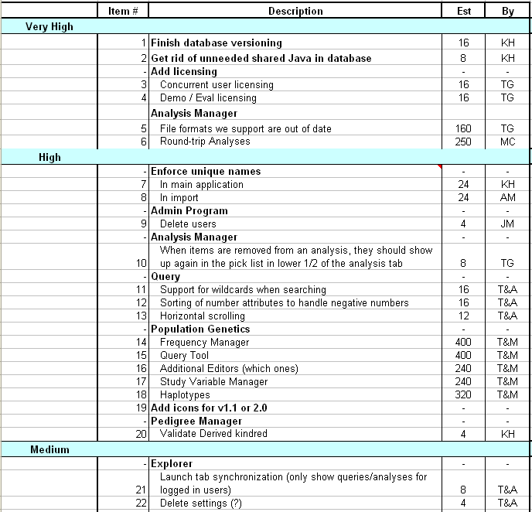
Sample Product Backlog

Slide 228
From Sprint Goal to Sprint Backlog
Scrum team takes the Sprint Goal and decides what tasks are necessary
Team self-organizes around how they’ll meet the Sprint Goal
  Manager doesn’t assign tasks to individuals
Managers don’t make decisions for the team
Sprint Backlog is created

Slide 229
Sprint Backlog during the Sprint
Changes
  Team adds new tasks whenever they need to in order to meet the Sprint Goal
  Team can remove unnecessary tasks
  But: Sprint Backlog can only be updated by the team
Estimates are updated whenever there’s new information

Slide 230
Sprint Backlog
A subset of Product Backlog Items, which define the work for a Sprint
Is created ONLY by Team members
Each Item has it’s own status
Should be updated every day

Slide 231
Sprint Backlog
No more than 300 tasks in the list
If a task requires more than 16 hours, it should be broken down
Team can add or subtract items from the list. Product Owner is not allowed to do it

Slide 232
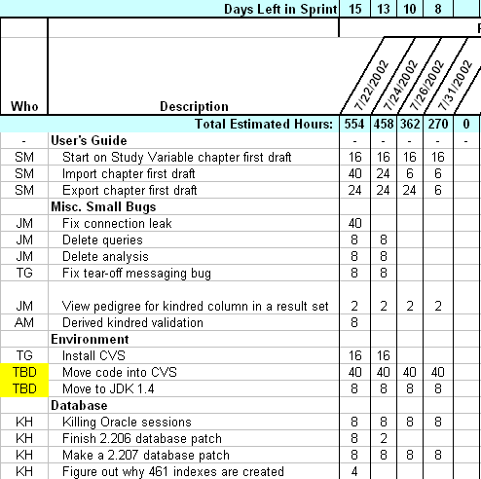
Sample Sprint Backlog

Slide 233
Burn down Charts
Are used to represent “work done”.
Are wonderful Information Radiators
3 Types:
  Sprint Burn down Chart (progress of the Sprint)
  Release Burn down Chart (progress of release)
  Product Burn down chart (progress of the Product)
JASS 2006

Slide 234
Sprint Burn down Chart
Depicts the total Sprint Backlog hours remaining per day
Shows the estimated amount of time to release
Ideally should burn down to zero to the end of the Sprint
Actually is not a straight line

Slide 235
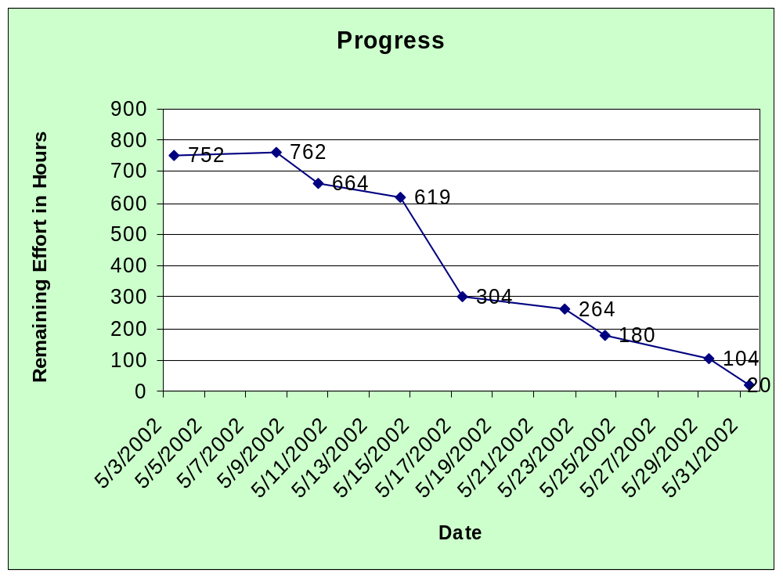
Sprint Burndown Chart

Slide 236
Release Burndown Chart
Will the release be done on right time?
X-axis: sprints
Y-axis: amount of hours remaining
The estimated work remaining can also burn up

Slide 237
Product Burndown Chart
Is a “big picture” view of project’s progress (all the releases)

Slide 238
Scalability of Scrum
A typical Scrum team is 6-10 people
Jeff Sutherland - up to over 800 people
"Scrum of Scrums" or what called "Meta-Scrum“
Frequency of meetings is based on the degree of coupling between packets

Slide 239
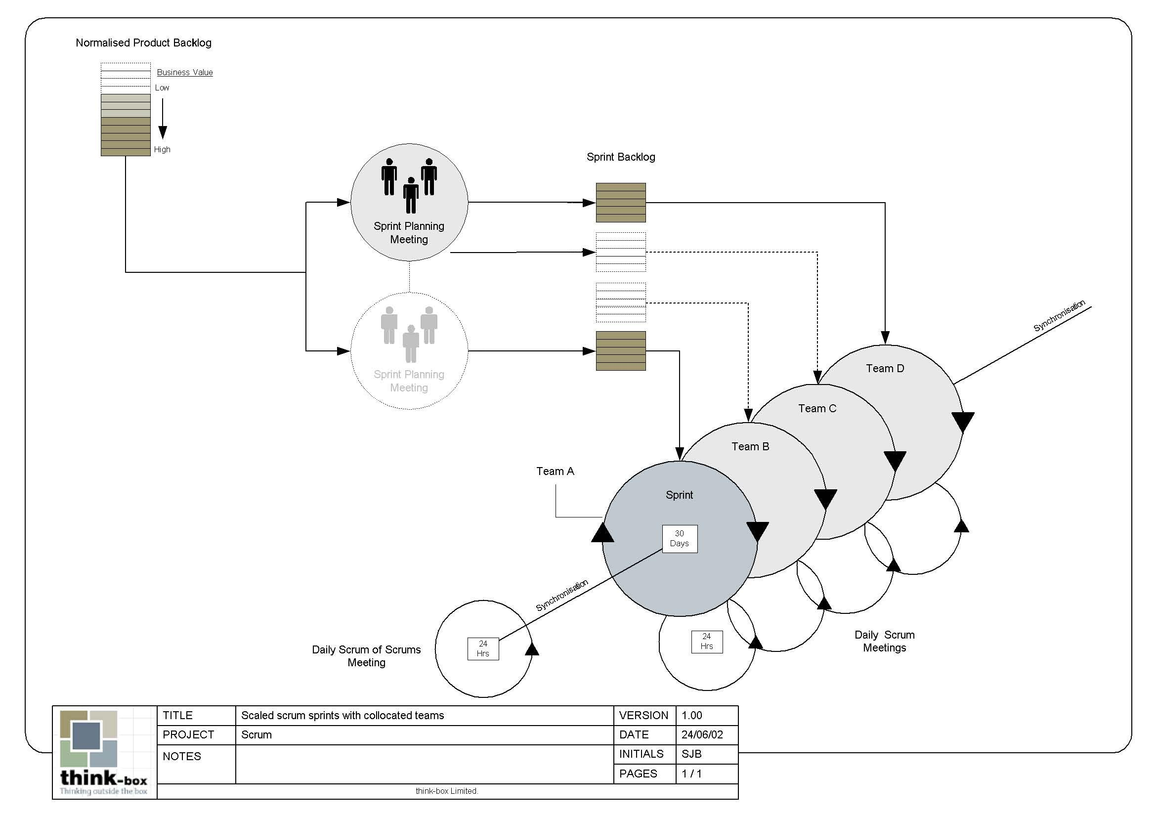
Scalability of Scrum

Slide 240
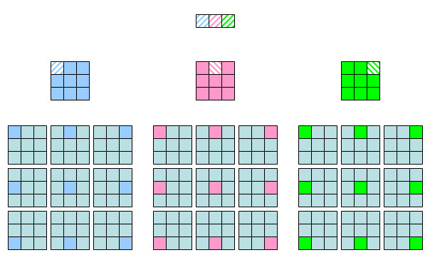
Scalability of Scrum

Slide 241
Thanks

Slide 242
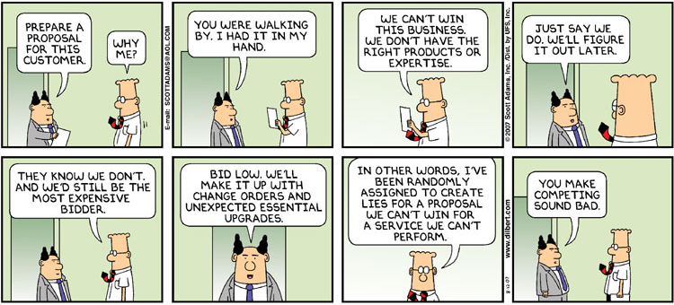
Feasibility Analysis and Bidding

Slide 243
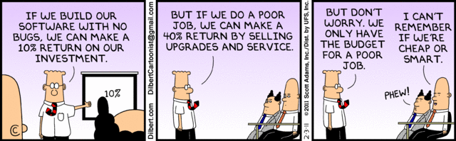

Slide 244
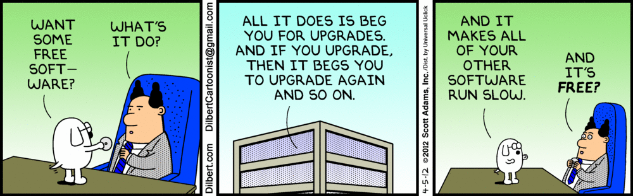

Slide 245
